Slide 1

Software Progress
Introduced by
Sakif Ahmed Abir (151014085)

Slide 2


eTo-Let Management System

Slide 3

Requirement
Design
Code
Test
Process Flow

Slide 4

What is Scrum ?
*Scrum Master
*Product Owner
*Project Team

Slide 5

Responsibility of Scrum Master
Lead a team
Reporting
Check quality
Shield the team
Communication
Monitoring & Tracking

Slide 6
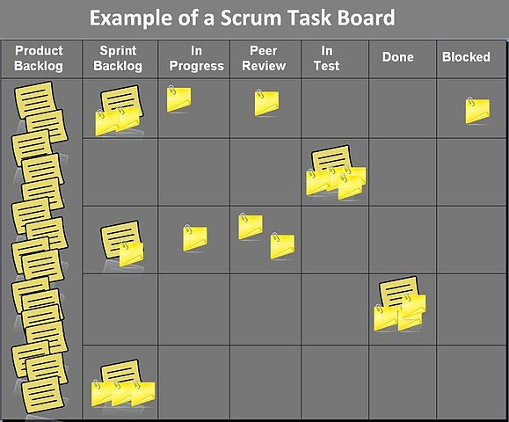
*Encourage.
*Work together.
*Taking Review.
*Discuss
Daily Scrum Meeting & Review

Slide 7
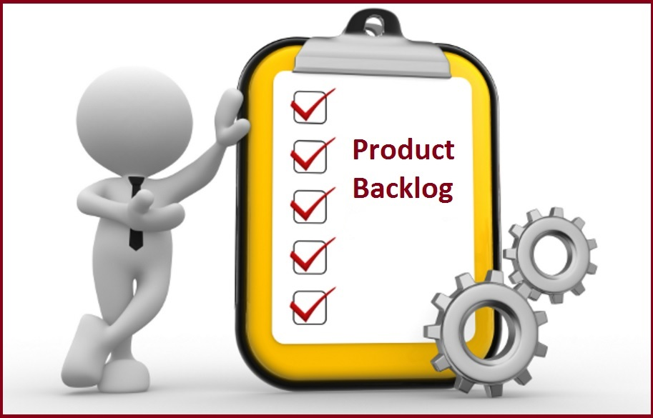
Story | Estimate | Priority | Status
User can be sign up to create account | 2 | Medium | Done
User can be able to login | 3 | High | Done
User can be able to change password | 2 | Medium | In-Process
User can be able to check apartment with location | 8 | High | In-Process
User can be able to booking confirmation | 6 | High | Not Start yet
User can be able to add, change or remove booking | 6 | Medium | Not Start yet
An admin can able to take any action like remove unauthorized user | 4 | Medium | Not Start yet
An admin can be able to check all list of login account | 4 | High | Not Start yet
Total 35

Slide 8

Sprint
Backlog
Story | Task | Sun | Mon | Tue | Wed | Thu | Status
 | Code of create account & login | 3 |  | 2 |  |  | Done
 | Code of change password | 2 | 4 | 2 | 1 | 2 | In-process
User Related | Testing theses code |  | 2 | 1 |  | 1 | In-process
 | Write online help | 4 |  | 2 | 3 | 2 | In-process
Total |  | 9 | 6 | 7 | 4 | 5

Slide 9
Burndown Chart
Hours
Days

Slide 10


